Slide 1
Airbnb Chicago Visualization Project Guyang Zhang, Yu, Liu
File created on: 2022-05-08 4:07:38 PM

Slide 2
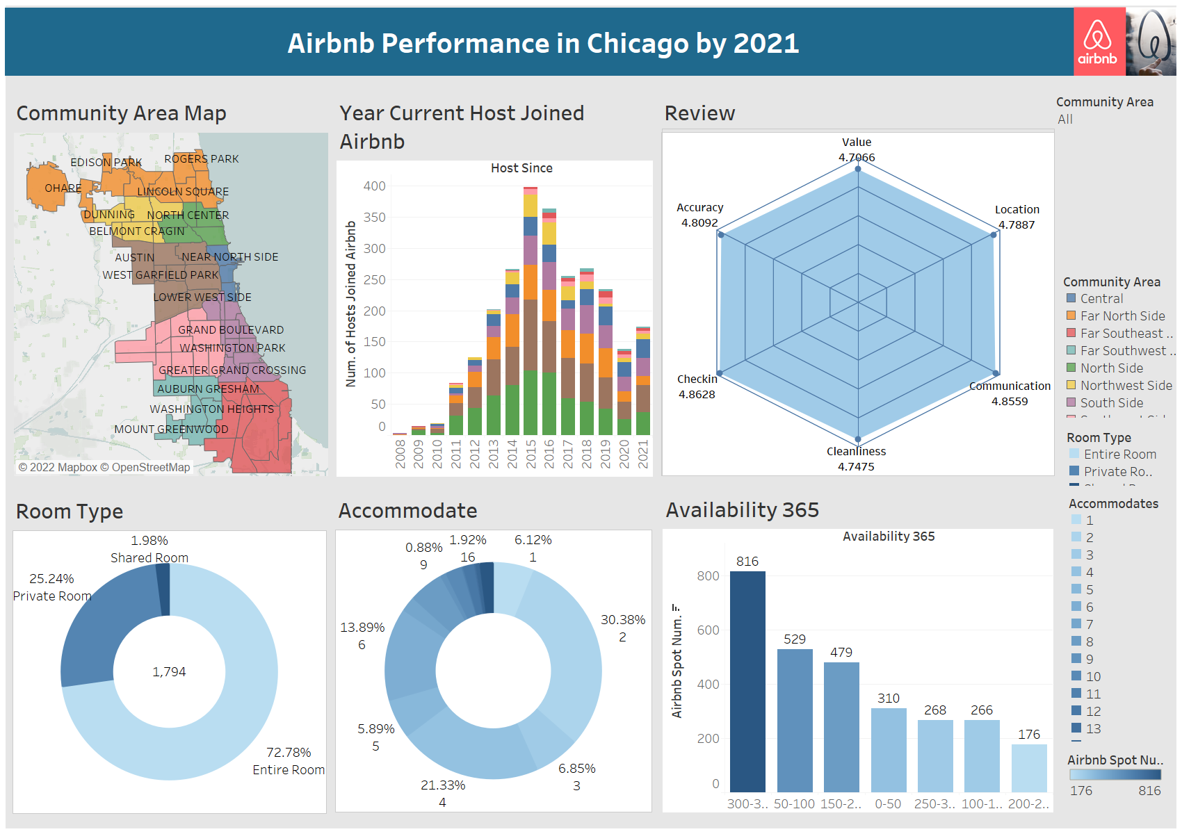

Slide 3
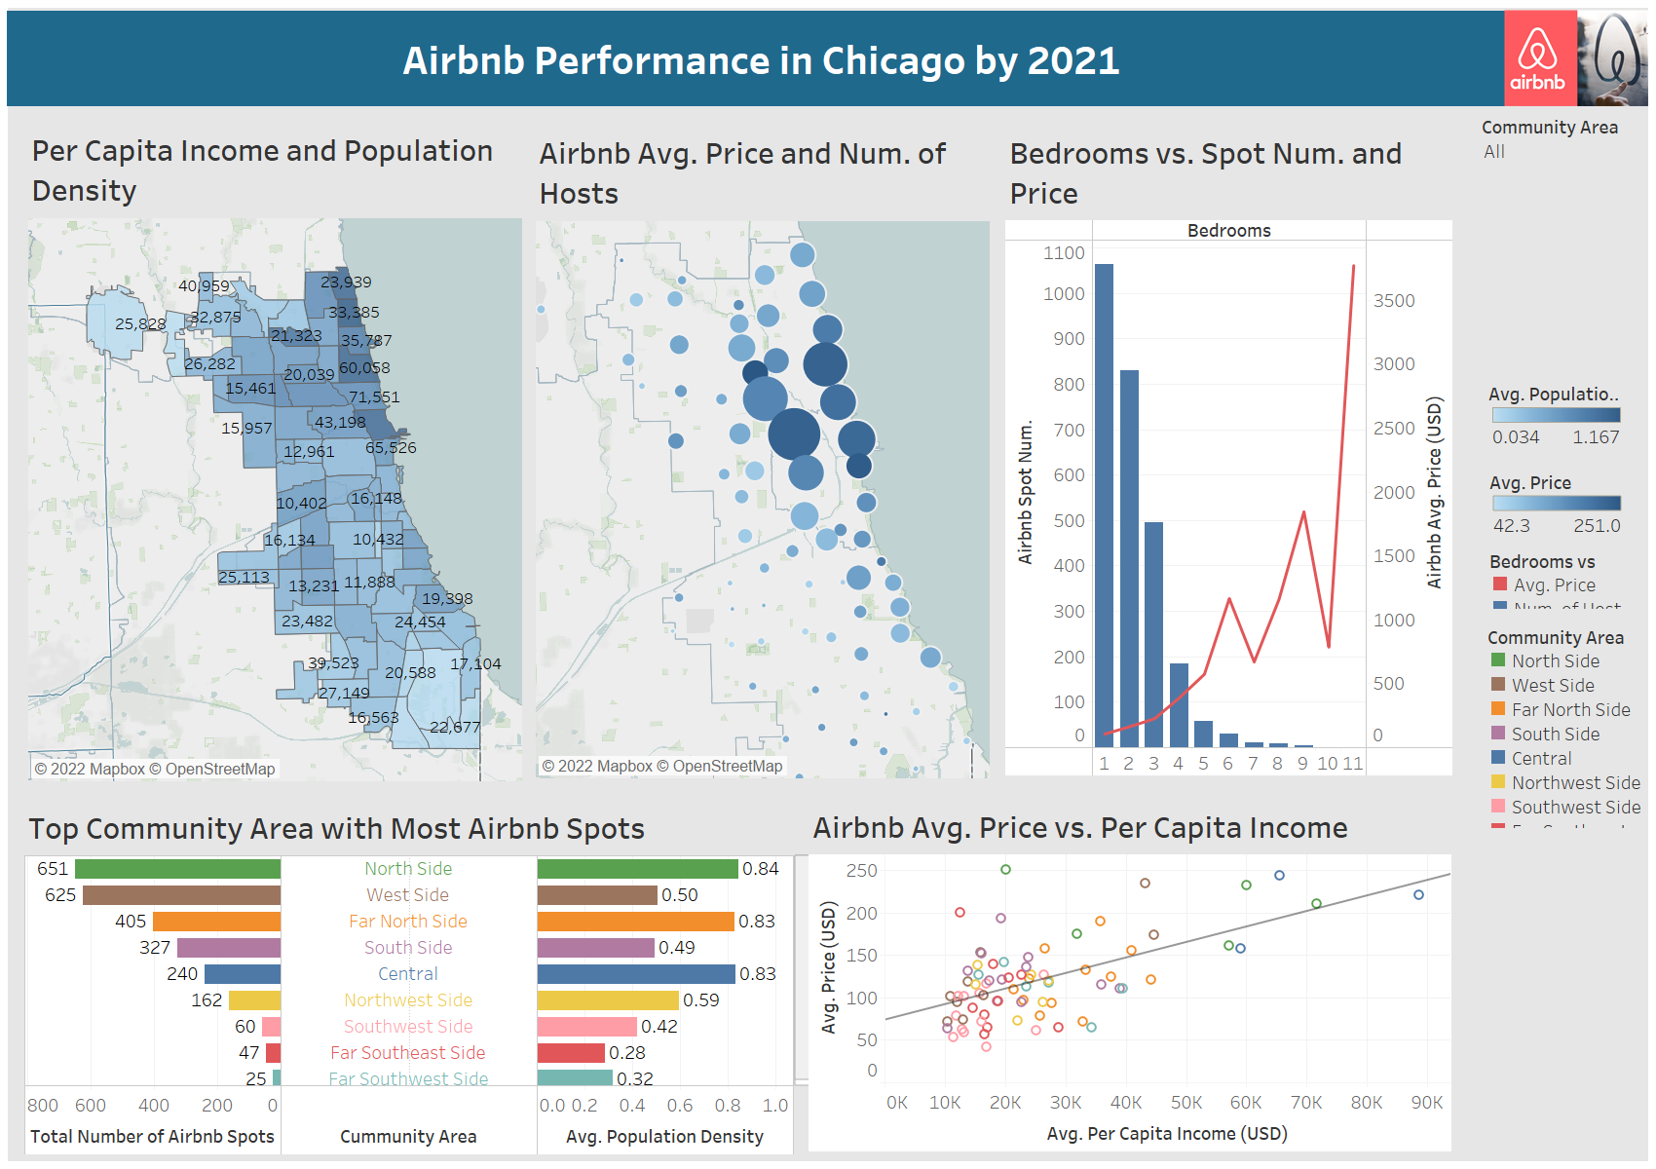

Slide 4
